Slide 1
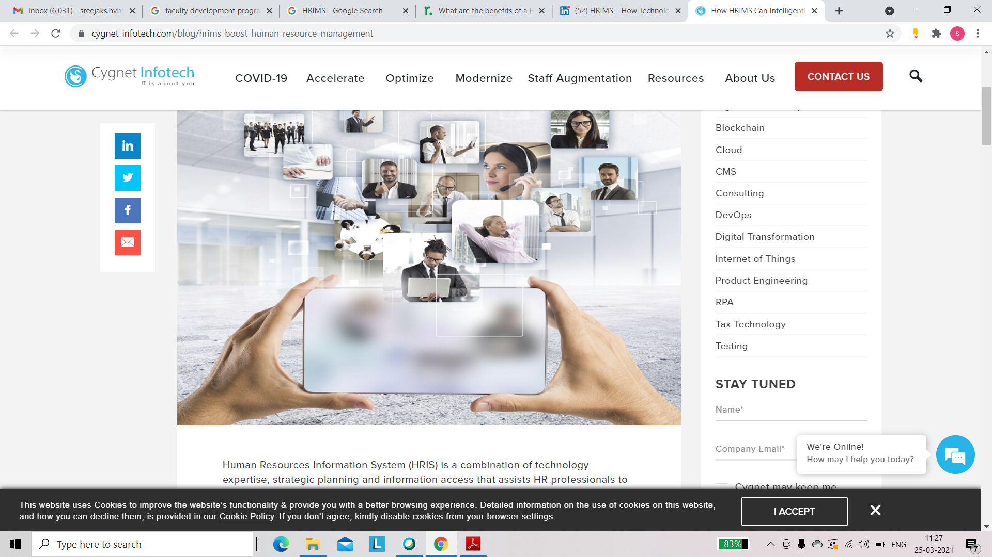
HR Information Management System (HRIMS)
Unit 5

Slide 2
Human Resource Information Management System
A computerized skills inventory for acquiring, storing, analyzing, and controlling the flow of information throughout an organization.

Slide 3
Activities of HRIMS
Recruitment
Payroll
Time & Attendance

Slide 4
Modules Can Strengthen HRIMS
Performance Management System (PMS)
Learning Management System (LMS)
Employee Self-Service (ESS)
Employee Database Management
HR Reports & Analytics

Slide 5

Need for HRIMS
Reduce Wasted Time
Increase Accuracy
Greater Productivity and Efficiency
Greater Consistency
Improved Data Security
Less Paperwork
Better Insights, Better Decision Making
Cost Savings
Transforming HR into a Strategic Partner

Slide 6
Benefits of a HRIMS

Slide 7
FOR ORGANISATIONS
Assists with compliance/reporting requirements of local, state and federal legislation
Reduction in administration and other overhead costs across the organisation
Employee and other workplace data can be stored securely (better meeting privacy laws), and easily accessed by those who are granted permissions (HR, senior and line managers)
Provides a tool for developing closer links between HR management and planning, and a communication platform for HR managers, line managers and senior management
Workforce trends can be monitored and addressed (e.g. external labour market, employee absence, turnover, wastage and career paths), and benchmarking activities undertaken
Future costs of targeted initiatives can be determined
Potential for better globalisation for geographically dispersed or multi-national companies, as all staff have access to same system and same information channels.

Slide 8
FOR MANAGERS
Direct access to current employee information and data to better monitor individual and/or group performance (e.g. leave, absences, performance ratings/comments)
Direct access to work area data to assist with evaluation of programs or policies, and/or day-to-day operational issues
Support strategic decision making (decisions related to both people and processes).

Slide 9
FOR EMPLOYEES
Ability to review and check accuracy of own information and data (e.g. pay, leave balances)
Ability to update own information and data as required (e.g. leave requests, personal contact details)
Some systems also allow for employees to connect with their manager or HR team online for confidential advice and assistance.

Slide 10
FOR HR
More time to focus on strategic initiatives – less time tending to staff enquiries and workforce reporting preparation
Improved HR planning and initiative development (better alignment to business needs)
More efficient processing – focus on checking data, rather than preparing
Faster response times, more accurate information, less opportunity for human error
Direct access to work area data to assist with evaluation of programs or policies, and/or day-to-day operational issues

